Slide 1
Progress Presentation: Statistical and Time Series Analysis of La Liga (Soccer Tournament)
By Abhishek Chaudhary

Slide 2
Agenda:
Here’s what you’ll find in this Presentation:
Overview and Objective of the Player Dataset
Initial Statistical Analysis.
Key Insights from Statistical Analysis.
Time Series Analysis: Player Performance Over Time.
Machine Learning

Slide 3
Data Description
Overview
This data set contains player data for the 2014-2023 seasons for the following league: La liga
Dataset Information
6,062 entries and 20 columns of player statistics.
Objective: To analyze and track player performance through statistical and time series methods.
Model Used : Regression, Time series

Slide 4
Key Objectives.
Who are the most consistent goal scorers over time?
How does player performance change with age or over the course of a career?
How do team strategies influence individual performance (e.g., shots vs. goals)?
Can we predict future goal-scoring based on past performance?

Slide 5
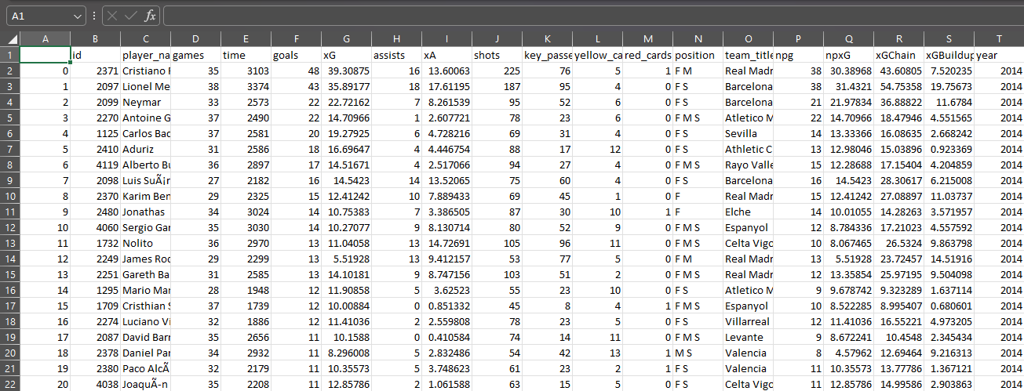
Data Description

Slide 6
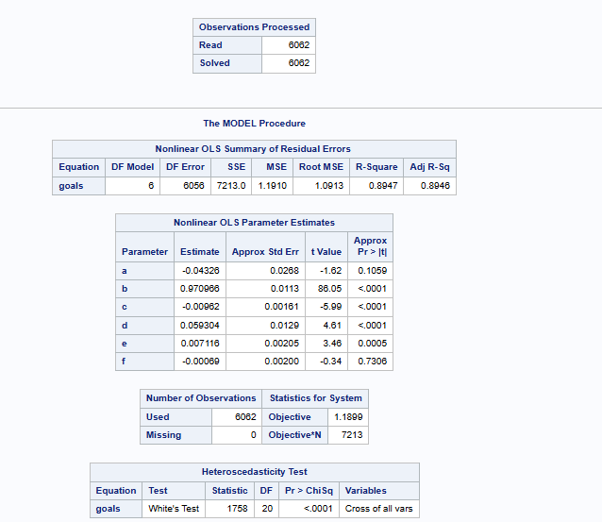
Regression Analysis
R-Square (R²): 0.8947:
This indicates that 89.47% of the variance in the number of goals can be explained by the predictors (xG, games, assists, shots, and key passes).
Key Passes (f): -0.00088 (p-value = 0.7306)
Not statistically significant (p > 0.05). Key passes do not significantly impact the number of goals in this model.

Slide 7
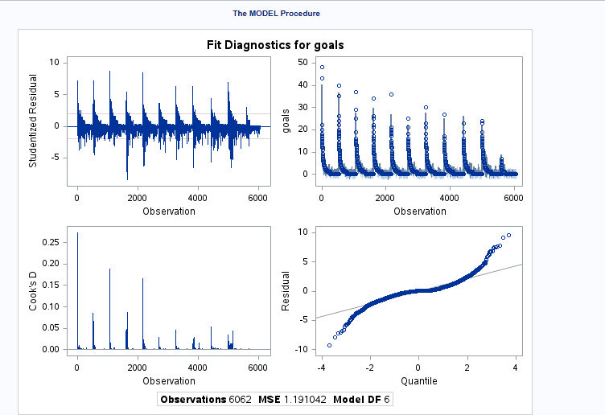
Regression Analysis
There is a noticeable cyclic pattern in the residuals, which suggests that the residuals are not randomly distributed
This might also hint at heteroscedasticity (unequal variance in residuals).
Most observations have very small Cook’s D values, indicating they are not overly influential.
The pattern and spread in the residuals suggest that the assumptions of Normality and identically distributed residuals may not hold.

Slide 8
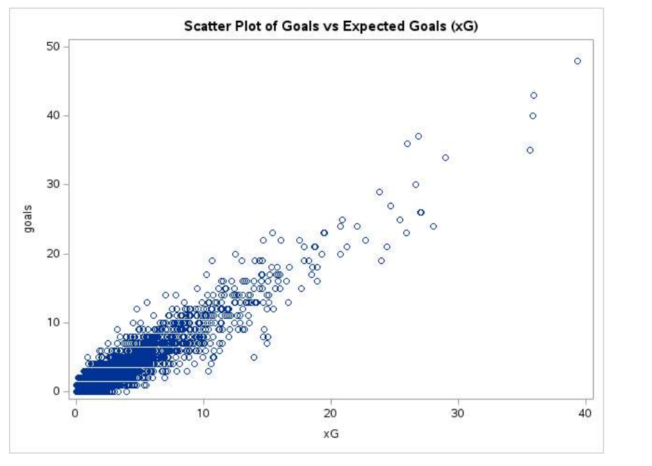
Regression Analysis
A few outliers can be observed at the higher end of both goals and xG, likely the top performers like Cristiano Ronaldo and Lionel Messi.
Most of the data points are clustered around the lower range of xG (0–10).

Slide 9
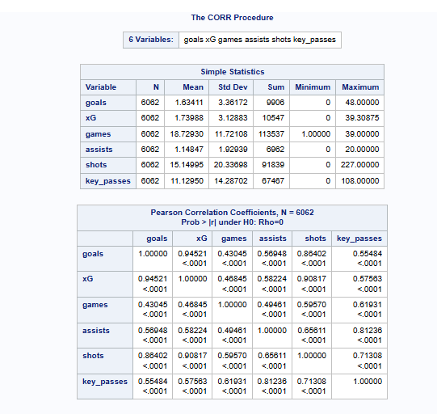
Correlation Matrix
The variables used are: goals, xG, games, assists, shots, and key_passes.
Goals vs. xG (Correlation = 0.94521): very strong positive correlation, meaning that as xG (Expected Goals) increases, the actual number of goals also increases.
Goals vs. Games (Correlation = 0.48465):This is a moderate positive correlation, indicating that players who play more games tend to score more goals

Slide 10
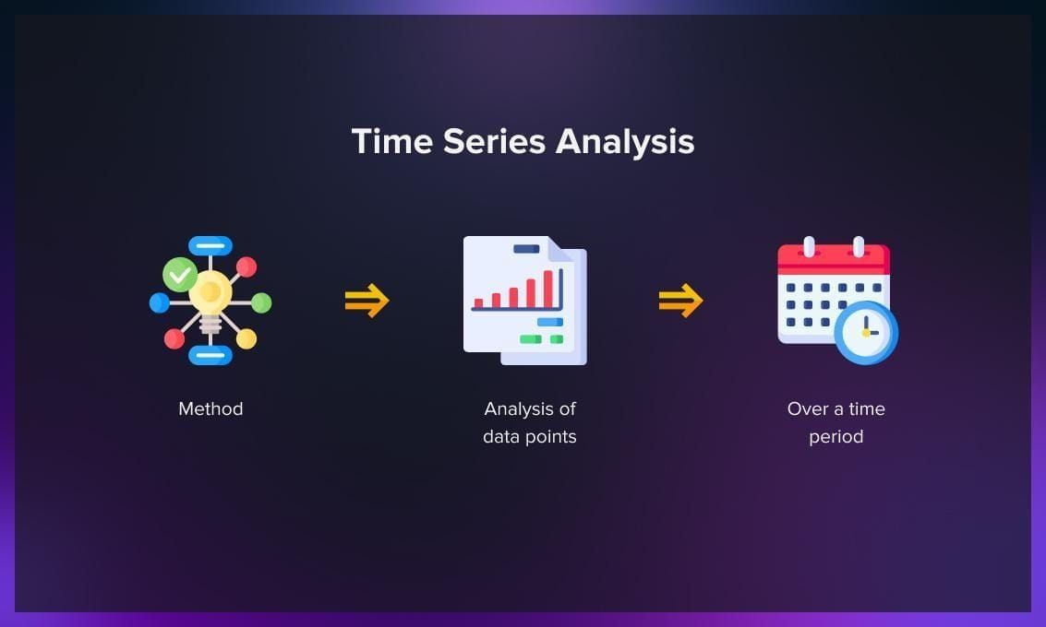
Time Series Analysis
Time series analysis is a statistical methodology for appropriate for an important class of research design.
Time series analysis is widely applied in various fields such as finance, economics, meteorology, and engineering.

Slide 11
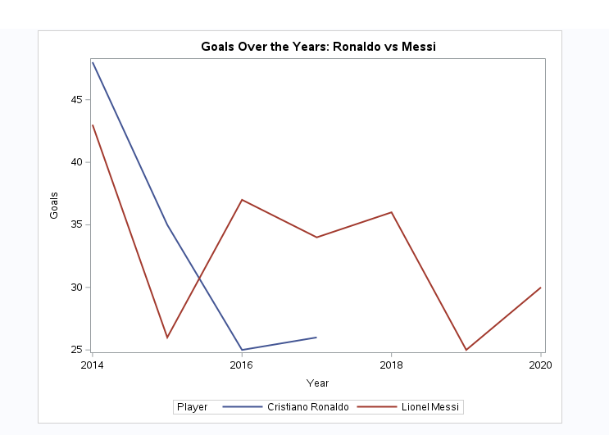
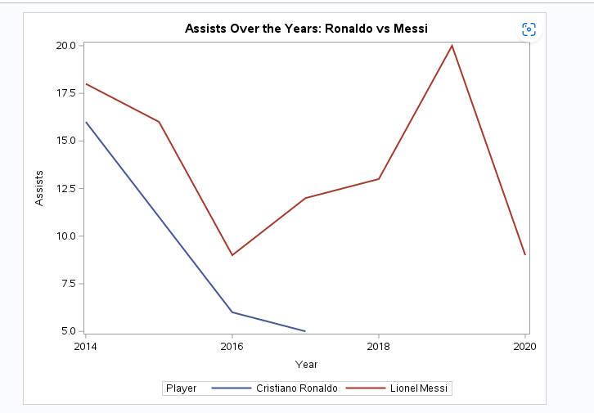
Time Series Analysis
Initial Peak (2014): Ronaldo starts with a higher goal count than Messi in 2014.
Messi's Consistency: Overall, Messi appears to have more consistent fluctuations
Comparison:
Ronaldo vs Messi: Messi clearly dominates the assist statistics, showing more playmaking ability during this time.

Slide 12
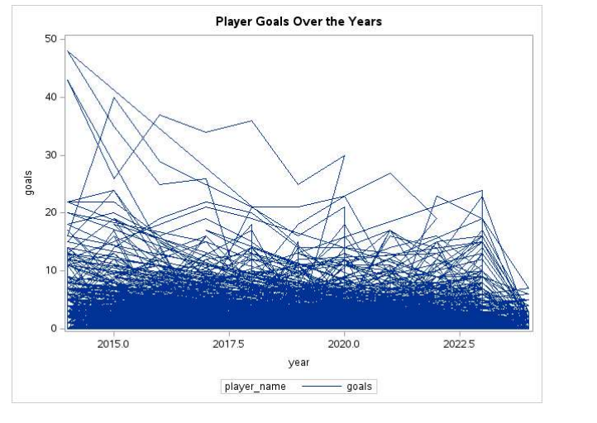
Time Series Analysis
The plot suggests that many players experienced peak goal-scoring performance around 2015–2017.
Cristiano Ronaldo: Peak performance in 2014 with 48 goals.
Lionel Messi:Peak performance in 2014 with 43 goals.Maintained consistent goal-scoring performance, often exceeding 30 goals per season.

Slide 13
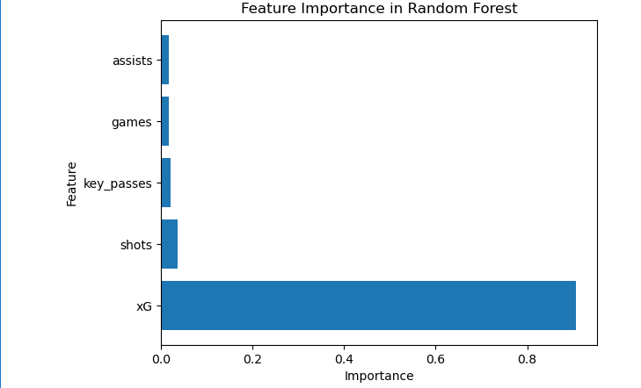
Random Forest
xG: (Expected Goals) is by far the most important feature, contributing nearly 90% to the predictive power.
Features like key_passes, games, and assists play a minor role in the model. However, their combined effect may still be meaningful when creating strategies for team performance.
shots: Contributes a small percentage to the model's performance. This makes sense as the number of shots can indicate attempts to score, but not all shots result in goals.

Slide 14
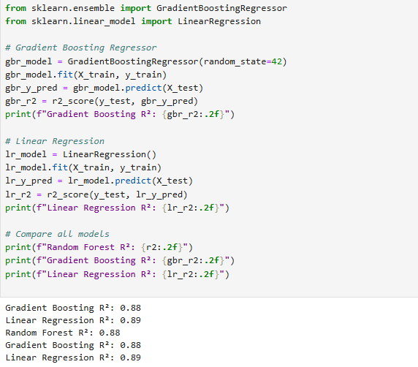
Random Forest
Gradient Boosting Regressor (R²: 0.88): Gradient Boosting achieves an R² of 0.88, indicating strong performance and robust predictions.
Random Forest Regressor (R²: 0.88): Random Forest also achieves an R² of 0.88, showing equal predictive power compared to Gradient Boosting in this dataset. Random Forest may still have advantages in interpretability due to its ability to provide feature importance easily.
Linear Regression (R²: 0.89): Surprisingly, Linear Regression achieves the highest R² (0.89), marginally outperforming both Random Forest and Gradient Boosting.This indicates that the relationships between predictors (xG, shots, etc.) and the target (goals) may be mostly linear, reducing the need for complex non-linear models.

Slide 15
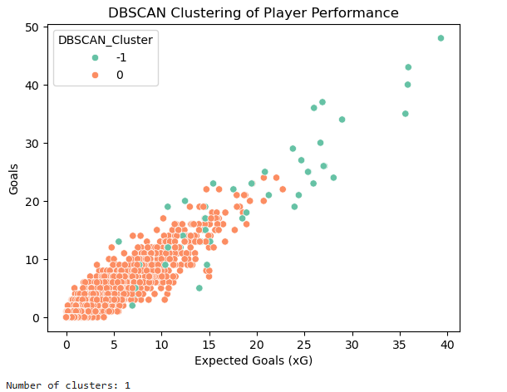
Random forest
Single Cluster Detected:
The clustering output shows only one significant cluster (Cluster 0), suggesting that the majority of players exhibit similar performance patterns based on xG and goals.
Outliers: Players with higher xG (>30) and goals (>30) stand out as outliers (green points). These outliers likely include elite players like Lionel Messi or Cristiano Ronaldo, whose performances deviate significantly from the average players.
Cluster Distribution:
Cluster 0 captures players with xG < 30 and goals < 30, forming the dense region in the plot.The relationship between xG and goals is strong within this cluster, reflecting the natural correlation between expected chances and actual goals scored.

Slide 16
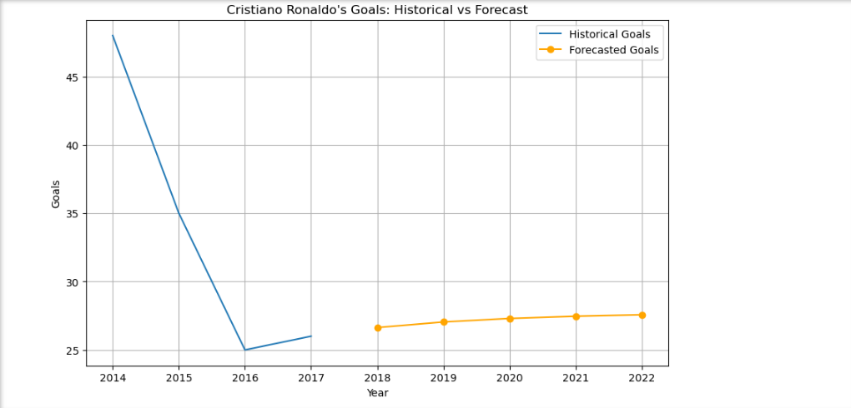
Times Series Model Selection
Historical Data:
Ronaldo's goal-scoring performance shows a sharp decline from 2014 to 2016, followed by a stabilization around the 25-goal mark in later years. This trend suggests a transition from peak performance to a consistent but lower output in recent years.
Forecasted Goals (2018-2022): The forecast predicts a stable performance, with goal counts remaining around 25–30 goals per season for the next five years. The model doesn't indicate any major upward or downward trends, reflecting Ronaldo's consistent output in his later career.
Stationary Behavior:
The forecast reflects the stationary nature of the time series after differencing, resulting in steady predictions rather than dramatic increases or decreases.

Slide 17

Time Series - ARIMA
sdssd
The ARIMA model predicts a gradual increase in Ronaldo's goal-scoring performance, stabilizing at approximately 27.5 goals per year.
Forecasted Values:
2018: 26.64
2019: 27.04
2020: 27.30
2021: 27.46
2022: 27.57

Slide 18
Challenges
Data Limitations
Short Time Frame:
The dataset includes only a few years of data (e.g., 2014–2017), which might not provide enough information for accurate long-term trend predictions.
Assumptions of the ARIMA Model
Stationarity Requirement:
ARIMA assumes stationarity, so non-stationary data must be differenced or transformed. This step can obscure the interpretation of the original trend.
Forecast Horizon Limitations
Long-Term Forecast Uncertainty:
Predicting five years into the future introduces significant uncertainty due to unmodeled factors (e.g., player transfers, career changes).

Slide 19
Conclusion
The time series analysis reveals several key insights about player performance:
Assists are more variable, with top playmakers like Messi consistently providing 15+ assists per season, while other players experience more fluctuation. This variability can be attributed to changes in team structure or roles.
The typical player peaks between 2013 and 2015, after which performance either stabilizes or declines. Career consistency is rare and generally limited to the best-performing players.

